Slide 1
FORMAL METHODS SOFTWARE EVOLUTION Instructor: Mam Fatima
Created By :
Hamza Mehmood | Bilal Arshad Farhan Nadeem| Jibran Naeem

Slide 2
Contents
Introduction
Software Evolution
Importance
Evolution & Repair Process
Evolution Dynamics

Slide 3
What is software evolution?
“Evolution is what happens
while you’re busy
making other plans.”
Usually, we consider evolution to begin once the first version has been delivered

Slide 4
Software Evolution
Software development does not stop when a system is delivered but continues throughout the lifetime of the system
After a system has been deployed, it inevitably has to change if it is to remain useful.
Business changes and changes to user expectations generate new requirements for the existing software.
Parts of the software may have to be modified to correct errors that are found in operation, to adapt it for changes to its hardware and software platform, and to improve its performance or other nonfunctional characteristic.

Slide 5
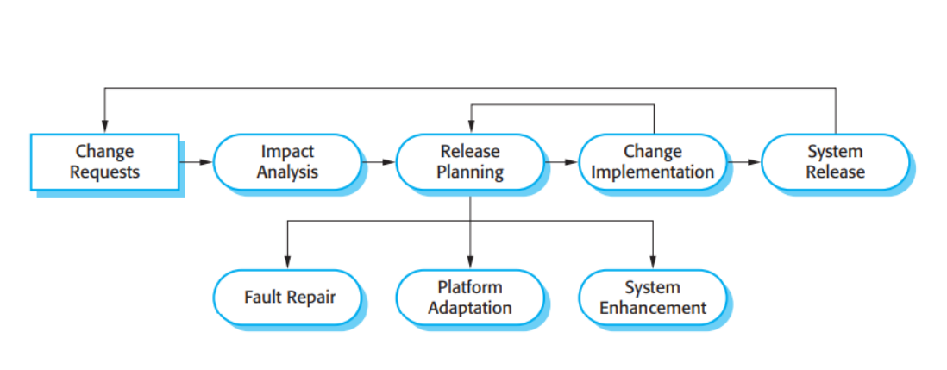
Evolution Process

Slide 6
Spiral Process Model
Think of software engineering as a spiral process with requirements, design, implementation, and testing going on throughout the lifetime.
You start by creating release 1 of the system.
Once delivered, changes are proposed.
Then the development of release 2 starts almost immediately.

Slide 7
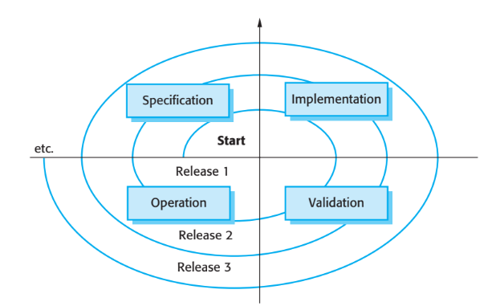
Spiral Model

Slide 8
Emergency Repair Process
Urgent changes may have to be implemented without going through all stages of the evolution process.
• If a serious system fault has to be repaired.
• If changes to the system’s environment (e.g. an OS upgrade) have unexpected effects.
• If there are business changes that require a very rapid response (e.g. the release of a competing product).

Slide 9
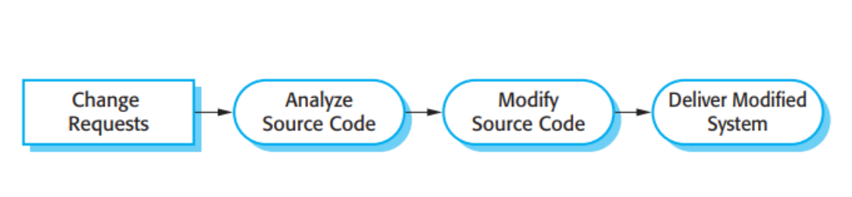
Emergency Repair Process

Slide 10
Importance
Organizations have HUGE INVESTMENTS in their Software Systems.
They are CRITICAL BUSINESS ASSESTS.
To maintain The Value of These Assets to the Business, they must be changed and updated
Companies Prefer Evolution on new Developments.

Slide 11
Evolution Process
There are TWO MAJOR Things in Software Evolution Process:-
Software CHANGE
Software Maintenance

Slide 12
Software Change It is unavoidable
• New requirements emerge when the software is used.
• The business environment changes.
• Errors must be repaired.
• New computers and equipment is added to the system.
The performance or reliability of the system may have to be improved.
A key problem for organizations is implementing and managing change to their existing software systems.

Slide 13
Types of Changes
• Repair of Software Faults-Changing a system to correct deficiencies in the way meets its requirements.
Adapt software to a different operating environment-Changing a system so that it operates in a different environment (computer, OS, etc.) from its initial implementation.
Add to or modify the system’s functionality-Modifying the system to satisfy new requirements.
• Improve the program structure and system performance-Modifying the system without changing functional behavior

Slide 14
Software Maintenance
• Maintenance does not normally involve major changes to the system architecture.
The system requirements are likely to change while the system is being developed because the environment is changing, Therefore a delivered system won’t meet it’s requirements.
Systems MUST be maintained therefore if they are to remain useful in an Environment.

Slide 15
Types of Maintenance
There are Three MAJOR Types in Software Maintenance:-
Corrective
Maintenance to Repair Software Faults
Adaptive
Maintenance to adapt Software to a Different Operating Environment.
Perfective
Maintenance to Add or Modify the Functionality.

Slide 16
Maintenance Cost Factors
Team stability:
Maintenance costs are reduced if the same staff are involved with them for some time.
• Contractual responsibility:
The developers of a system may have no contractual responsibility for maintenance so there is no incentive to design for future change.
• Staff skills Maintenance:
Staff are often inexperienced and have limited domain knowledge
• Program age and structure:
As programs age, their structure is degraded and they become harder to understand and change.

Slide 17
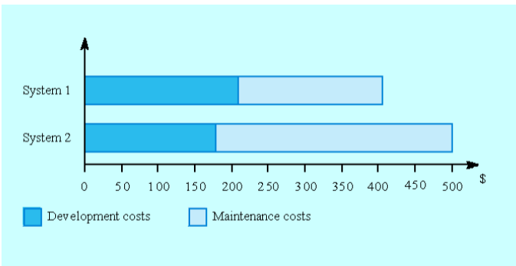
Development/Maintenance Cost

Slide 18
Program Evolution Dynamics
Program evolution dynamics is the study of the processes of system change.
• After major empirical studies, Lehman proposed that there were a number of ‘laws’ which applied to all systems as they evolved.
• These are sensible observations rather than laws. They are applicable to large systems developed by large organizations.

Slide 19
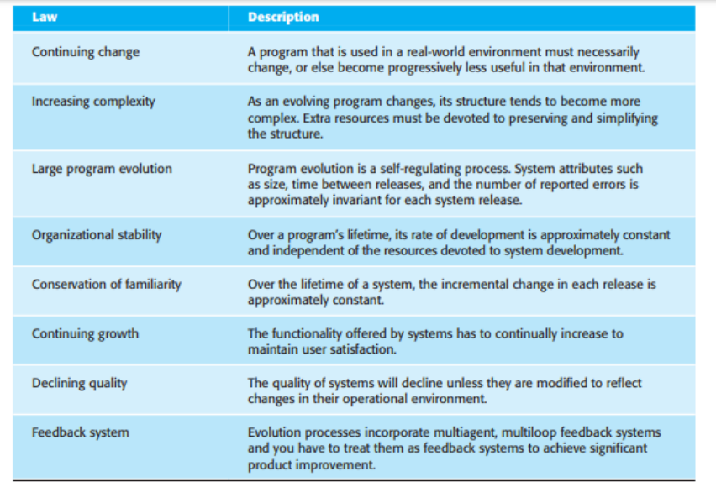
Lehman’s Law

Slide 20
In the absence of information, we jump to the worst conclusions.
That’s It!!!

